Slide 1
YANG based EVC Service Modeling in OpenDaylight
Date: 18-Mar-2018

Slide 2
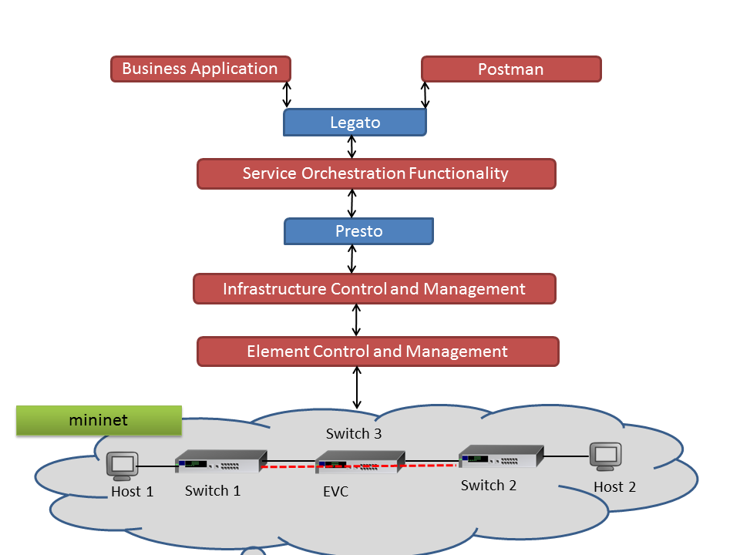
LSO Reference Architecture

Slide 3
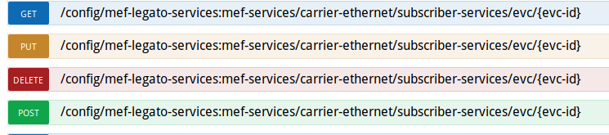
Legato APIs
http://localhost:8181/apidoc/explorer/index.html link to view Legato APIs
Notes:
We will create/delete EVPL (Ethernet Virtual Private Line) between 2 Endpoints which are located in different geographical locations. We will cover following things in today’s demo.
1. At first, we will create topology through Python script on Mininet to stimulate network
2.Take a look at topology on ODL (Open Day Light) deluxe
3. Next, we will delete flows that are set by ODL by default
4. We will verify traffic between flows and configuration from CLI
5. We will create Point to Point EVC (Ethernet Virtual Connection) between 2 endpoints via Legato
6. Take a look at Configuration and Operational data and Presto’s connectivity service list
7. Verify traffic between flows and configuration from CLI
8. Now we will delete that EVC
9. Take a look at Configuration and Operational data and Presto’s connectivity service list
10. Verify traffic between flows and configuration from CLI

Slide 4
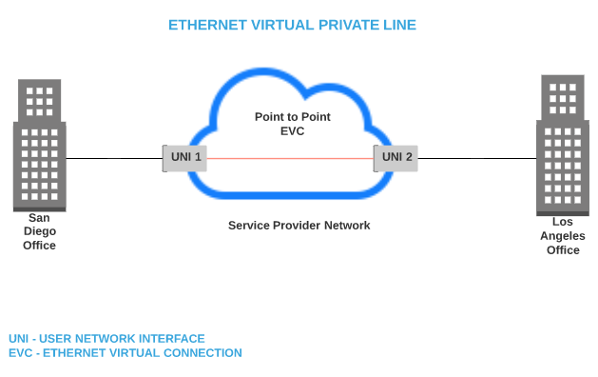
Ethernet Virtual Private Line (EVPL) Diagram

Slide 5
Demo – Legato API
Implementing EVPL (Ethernet Virtual Private Line)
Simulate network on mininet
Create EVC between 2 UNIs
Verify flow, traffic after EVC creation
Delete EVC
Verify flow, traffic after EVC deletion
Notes:
We will create/delete EVPL (Ethernet Virtual Private Line) between 2 Endpoints which are located in different geographical locations. We will cover following things in today’s demo.
1. At first, we will create topology through Python script on Mininet to stimulate network
2.Take a look at topology on ODL (Open Day Light) deluxe
3. Next, we will delete flows that are set by ODL by default
4. We will verify traffic between flows and configuration from CLI
5. We will create Point to Point EVC (Ethernet Virtual Connection) between 2 endpoints via Legato
6. Take a look at Configuration and Operational data and Presto’s connectivity service list
7. Verify traffic between flows and configuration from CLI
8. Now we will delete that EVC
9. Take a look at Configuration and Operational data and Presto’s connectivity service list
10. Verify traffic between flows and configuration from CLI

Slide 6
THANK YOU

